Slide 1
Summary of the project
The scope of the project is to create student i-card. He /she have to put their details on it and can create their user id. Student can add their demographic information in it.
So automation test case is all about automating this functionalities. Idea is to create all the process into the cypress.
It covers all the functional tests as well as give the result for that. Also it covers all the negative test cases that should not allow user to do.
Project Planning and Management
It created black box testing after tested most of the functional test cases.

Slide 2
Project coding
Used cypress for the creation of the first level test case and eclipse into the tool for the coding.
Used PHP for the coding the business logic

Slide 3
Project Coding with PHP using SDLC and automation with cypress
Coded Project with SDLC process and followed water fall life cycle since agile is not possible with small project.
Tested Project with the automation software and with manual test cases.
Created all the negative test cases and executed with cypress and manually too.

Slide 4
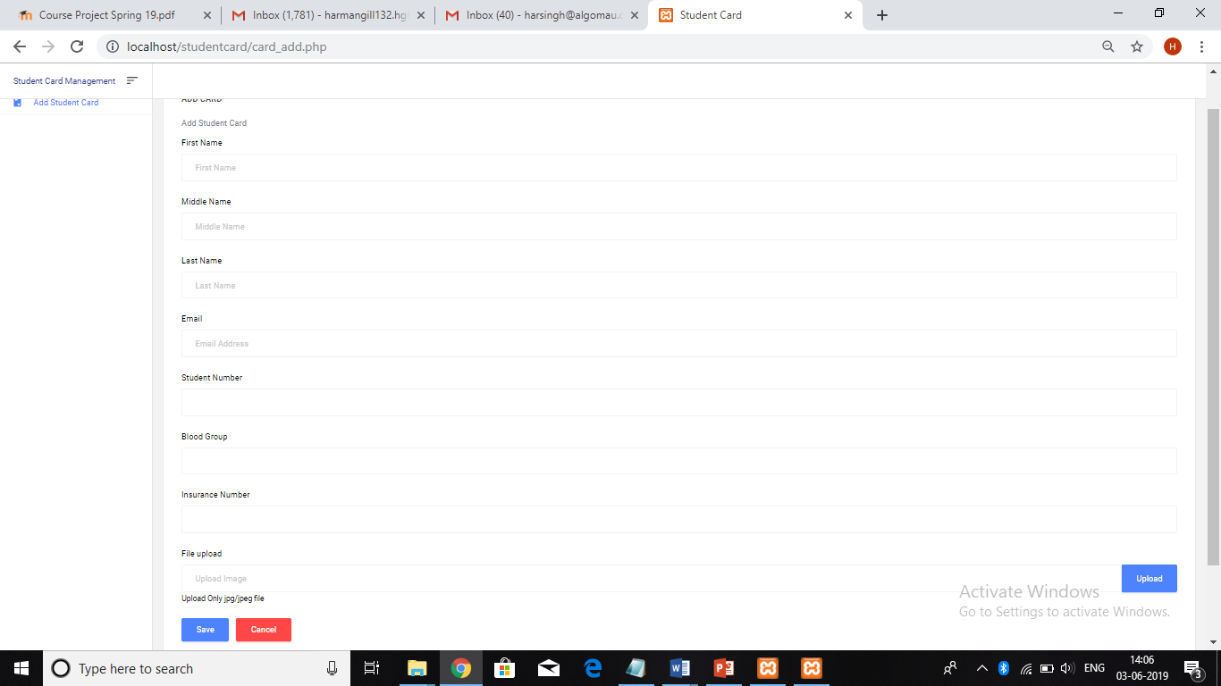
Project Add Student page Screenshot.

Slide 5
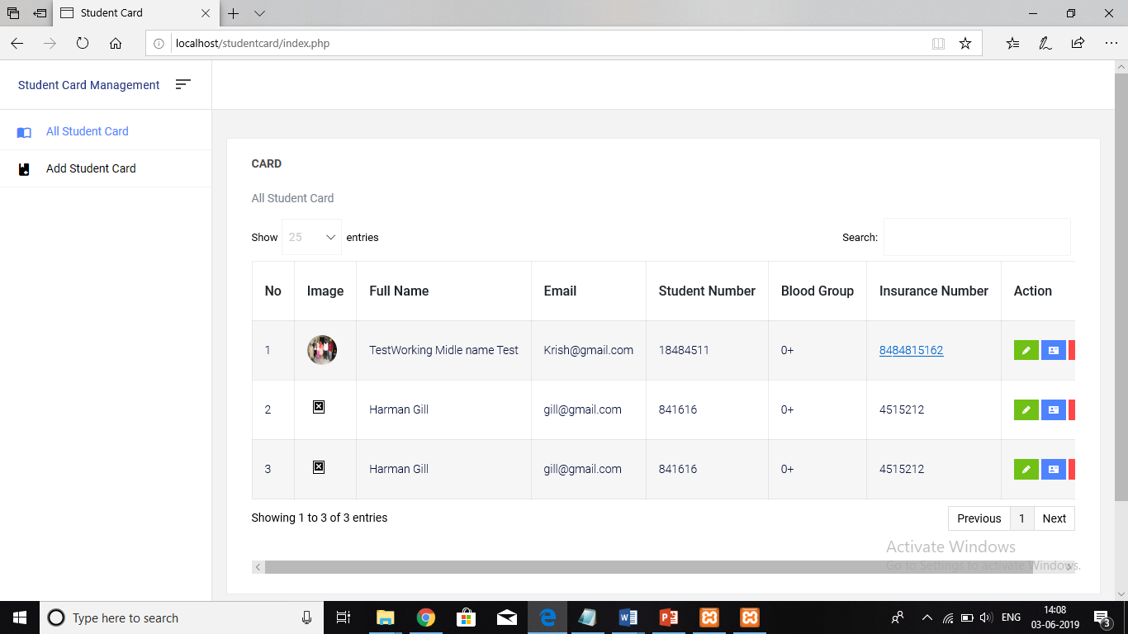
Student List page

Slide 6
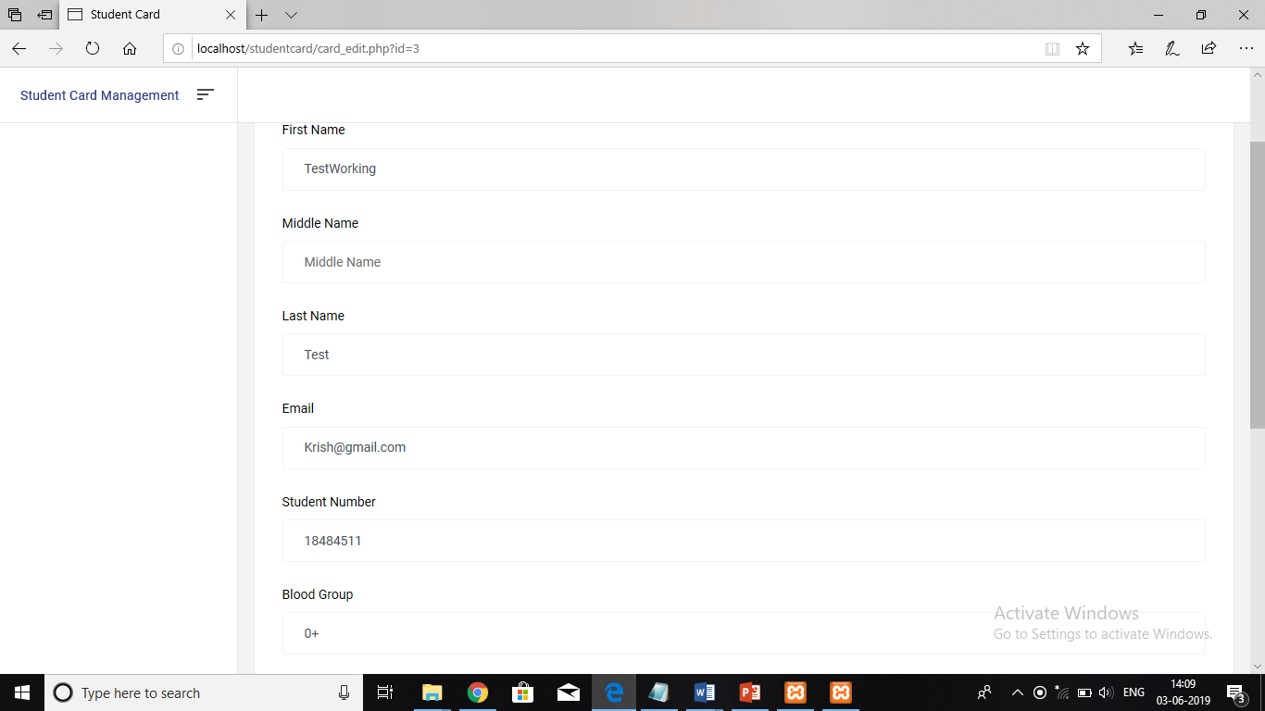
Edit page screenshot

Slide 7
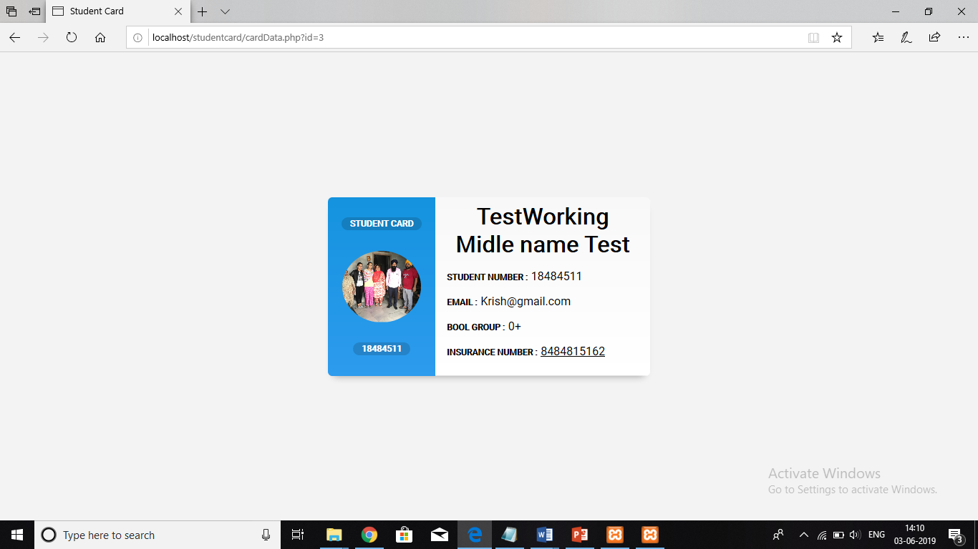
Student card screenshot generated by Project

Slide 8
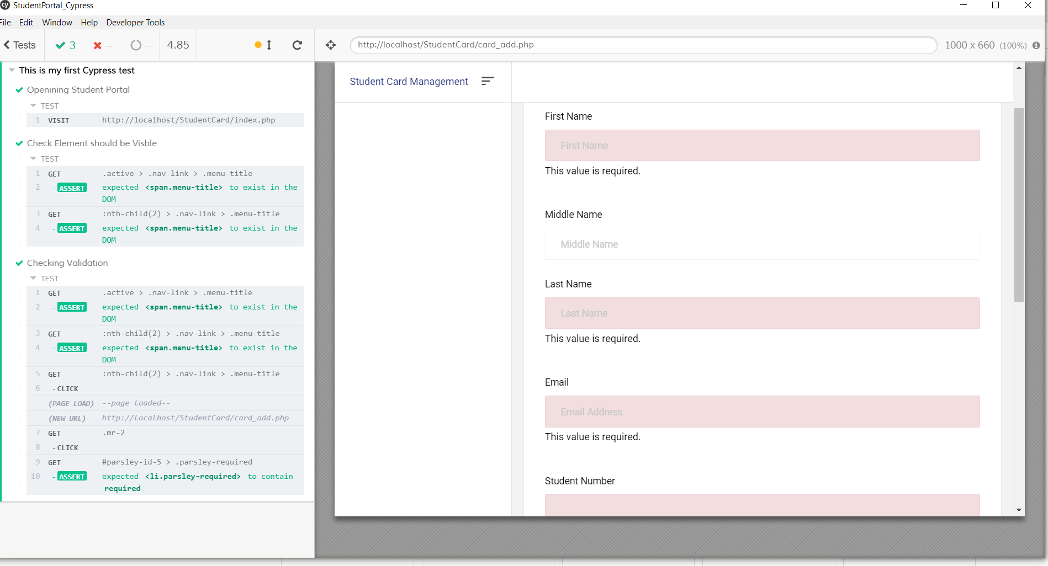
Test cases Check validations - Passed

Slide 9
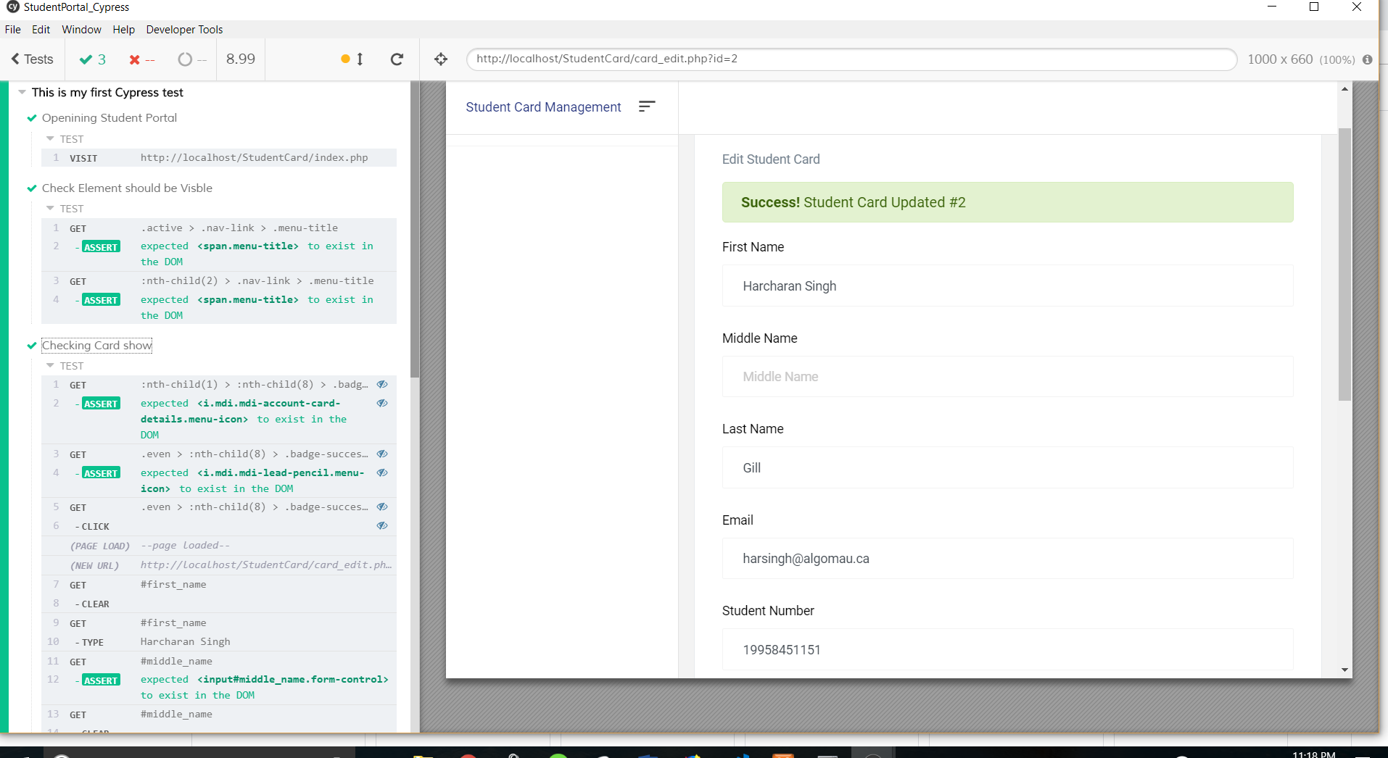
Updated student info - Passed

Slide 10
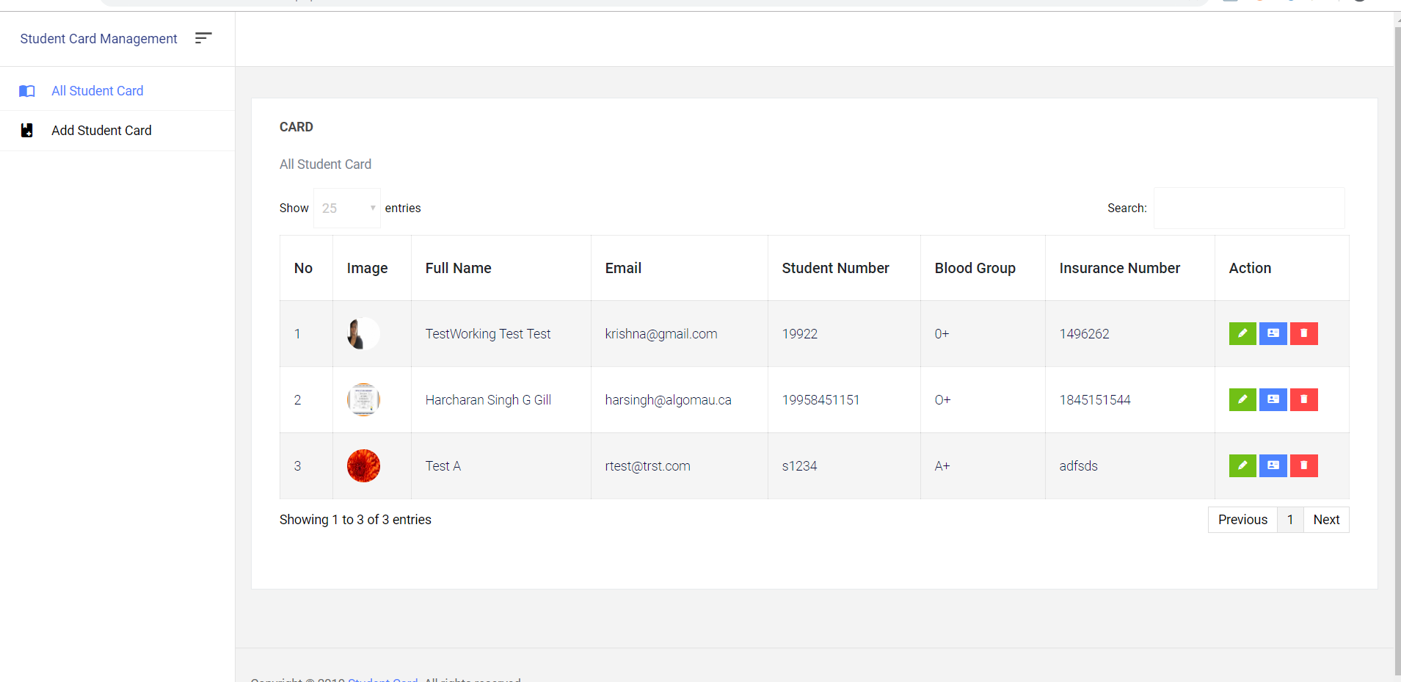
Registered students

Slide 11
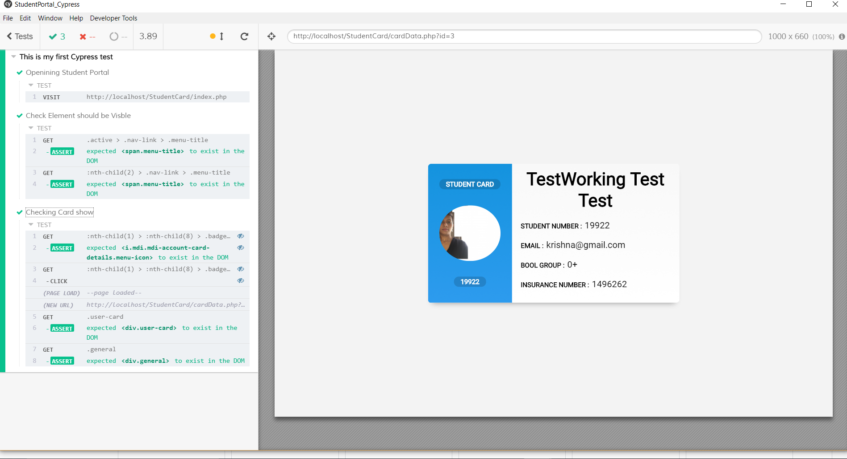
Display Student Card

